Slide 1
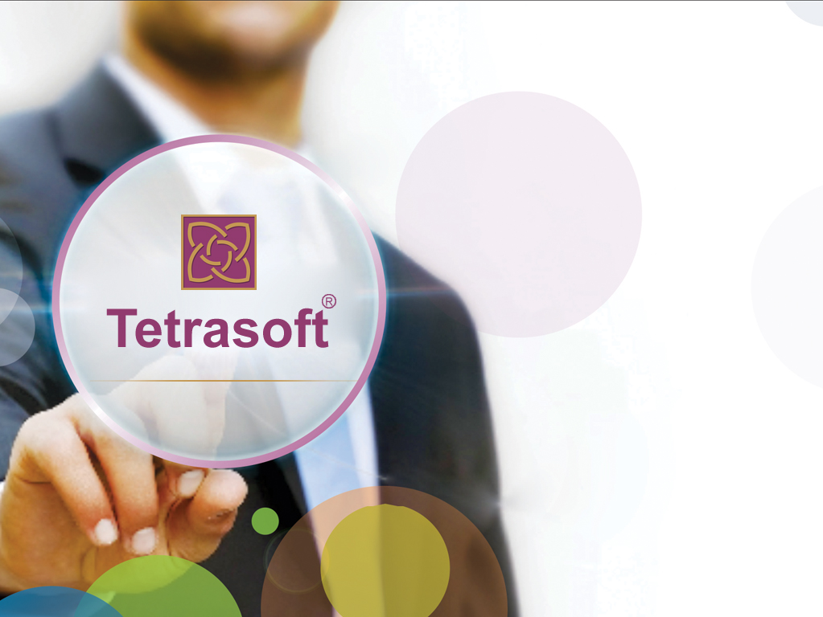
NIMBUS In Anthem
CMDM and LTSS

Slide 2

Agenda
What is Nimbus Platform? Why Nimbus? Where it fits in Anthem Business?
What is Nimbus Framework? Why Nimbus Framework? Why Anthem made it Open Source? How it is useful for External Developers?
What are the sub products/applications developed by Tetrasoft under Nimbus platform
What are the Challenges faced and Strategies applied.

Slide 3
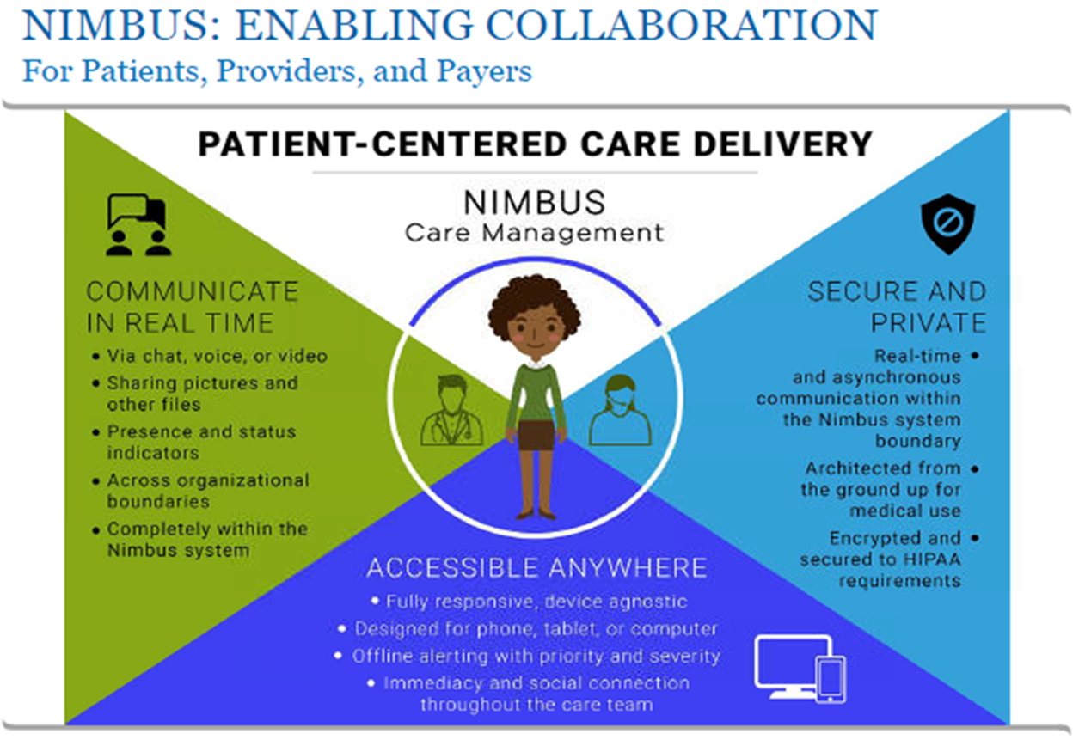

Slide 4
NIMBUS(Next generation care management platform) Overview
Project Nimbus is initiated by anthem for building the next generation care management platform with a focus on modernizing existing care management and offering care management products/applications to payers & providers to reduce cost & increase the quality of care by virtually integrated, Performance & Evidence based care
It is to enable or optimize the operational functions used by anthem to provide care/services/products to members , providers, payers as well as external customers.
Nimbus platform/products includes sub products/applications like
LTSS(Long Term Services and Support)
CMDM(Case management and Disease management)
CMDMClientAdmin
LTSSClientAdmin
BH (Behavioural Health),
UM (Utilization management)
EAP(Employee Assistance program)
Admin Builder(Assessment template Builder , Tasks , Activities )
These all are based/developed on Nimbus Framework, which is an open source being developed by Anthem.

Slide 5
NIMBUS(Next generation care management platform) Overview
Project Nimbus is initiated by anthem for building the next generation care management platform with a focus on modernizing existing care management and offering care management products/applications to payers & providers to reduce cost & increase the quality of care by virtually integrated, Performance & Evidence based care
It is to enable or optimize the operational functions used by anthem to provide care/services/products to members , providers , payers as well as external customers.
Nimbus platform/products includes sub products/applications like
LTSS(Long Term Services and Support)
CMDM(Case management and Disease management)
CMDMClientAdmin
LTSSClientAdmin
BH (Behavioural Health),
UM (Utilization management)
EAP(Employee Assistance program)
Admin Builder(Assessment template Builder , Tasks , Activities )
These all are based/developed on Nimbus Framework, which is an open source being developed by Anthem.
Notes:
The Nimbus Framework is a Java/Spring based platform dedicated to building highly configurable, workflow driven, and rich single page web applications through the use of configuration written atop the Java Virtual Machine and it is a collection of libraries and frameworks.
Benefits of using the Nimbus Framework:
Create new applications quickly.
Easy Configuration.
Cloud supportable .
Easily integrates with other systems.
Better User Interfaces , through code generation.
Develop new UI Controls based on standardized UX.
UI widget for capturing e-signature, Data export and Import.
Ability to print a view and generate a pdf of the printable view

Slide 6
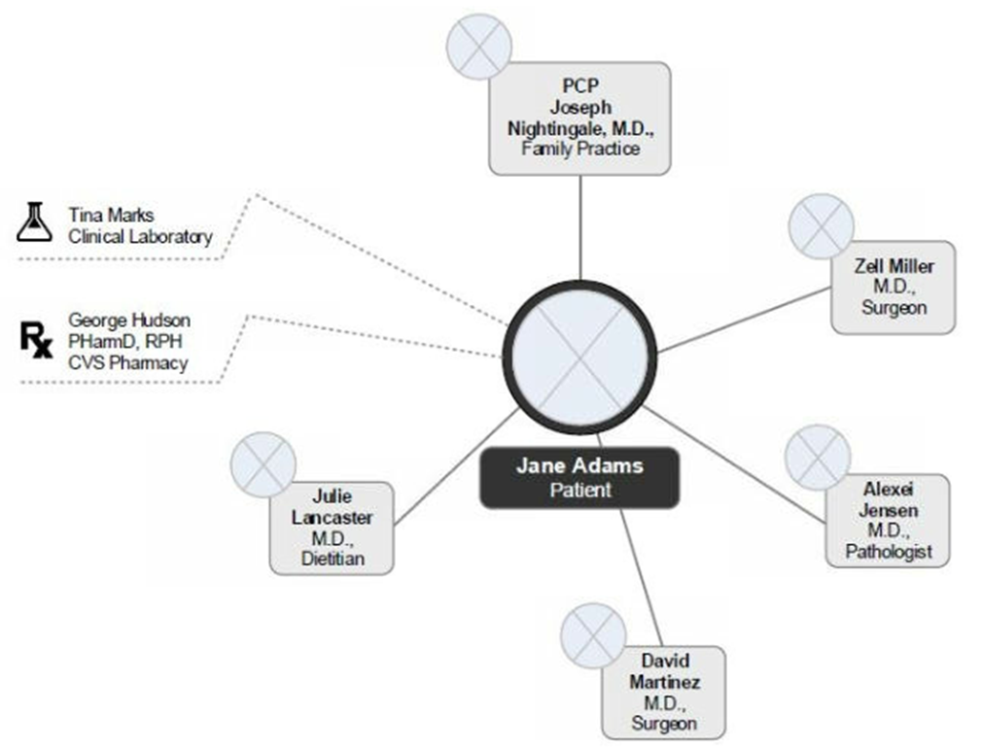


Slide 7
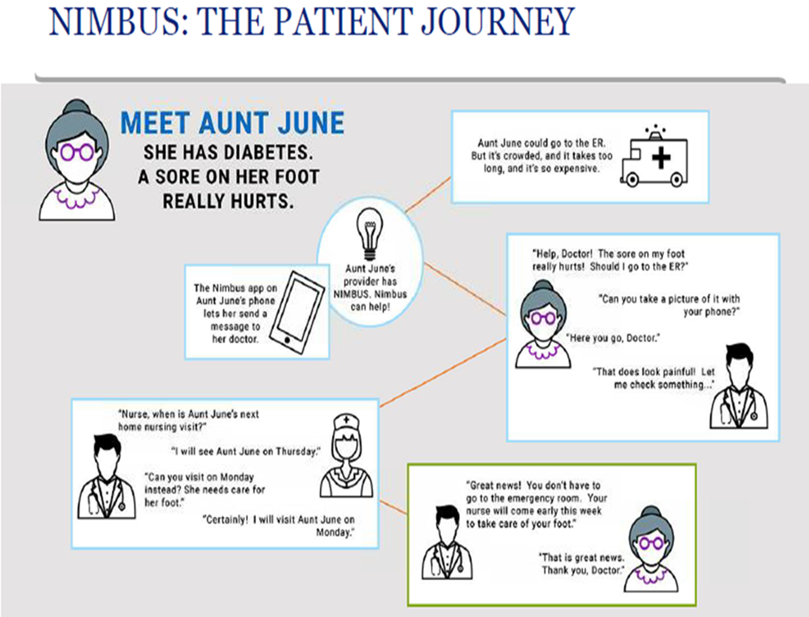

Slide 8
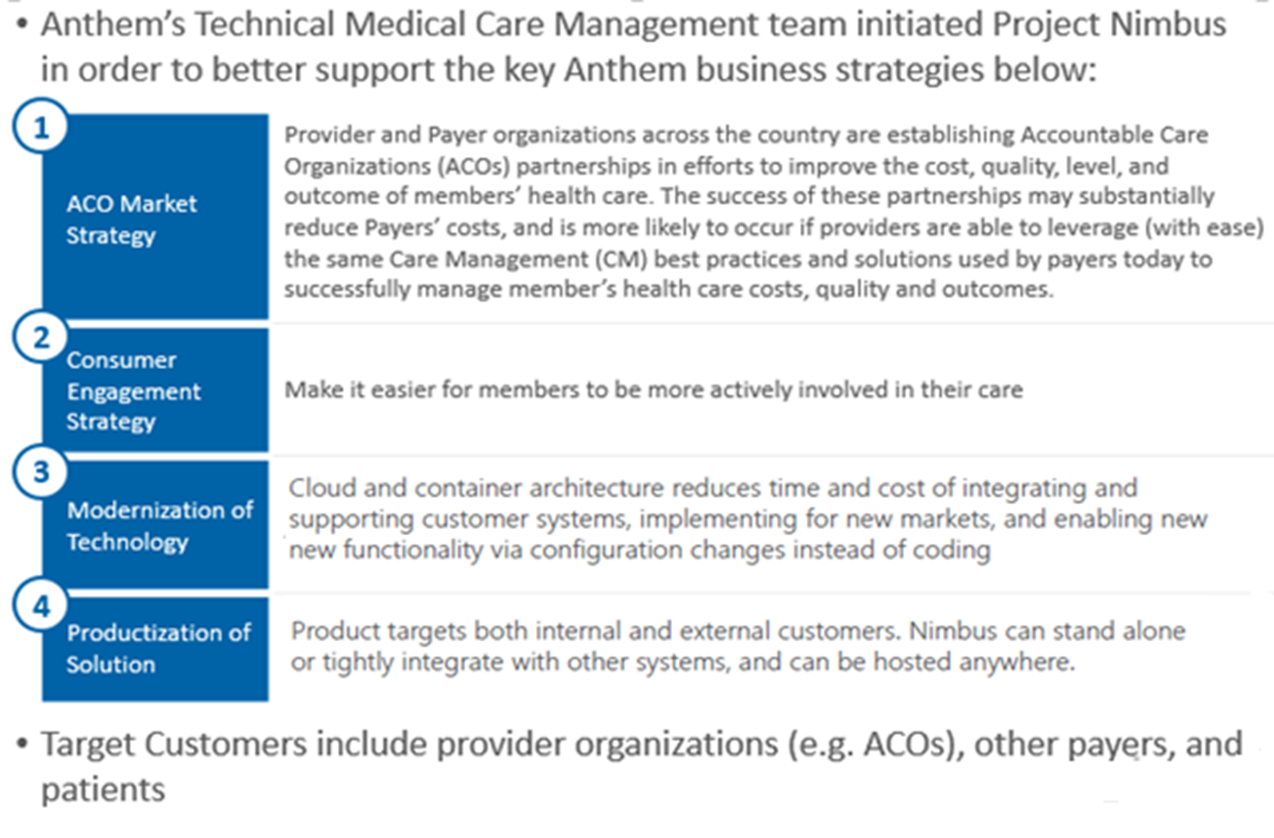
Who are the end users and where does Nimbus (Next generation Care Management) fit in the Anthem business flow ?

Slide 9
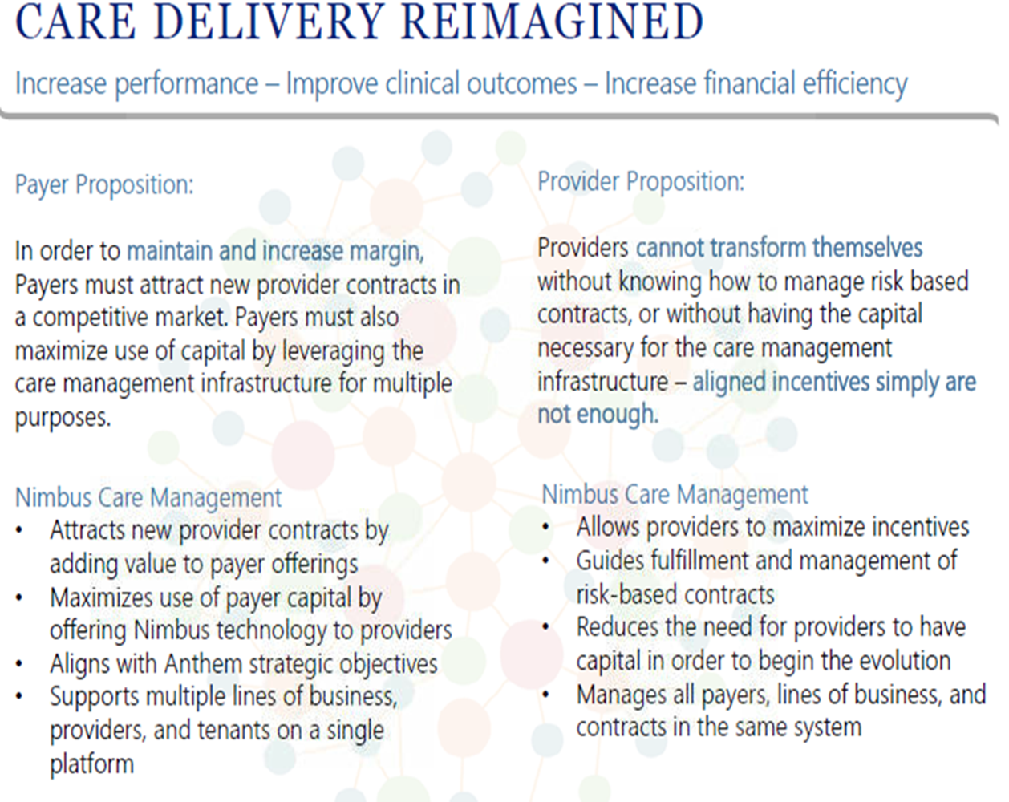

Slide 10
NIMBUS Framework
The Nimbus Framework is a Java/Spring based platform dedicated to building highly configurable, workflow driven, and rich single page web applications through the use of configuration written atop the Java Virtual Machine and it is a collection of libraries and frameworks.
Benefits of using the Nimbus Framework:
Create new applications quickly
Easy Configuration
Cloud supportable
Easily integrates with other systems
Better User Interfaces , through code generation
Develop new UI Controls based on standardized UX
UI widget for capturing e-signature, Data export and Import
Ability to print a view and generate a pdf of the printable view

Slide 11
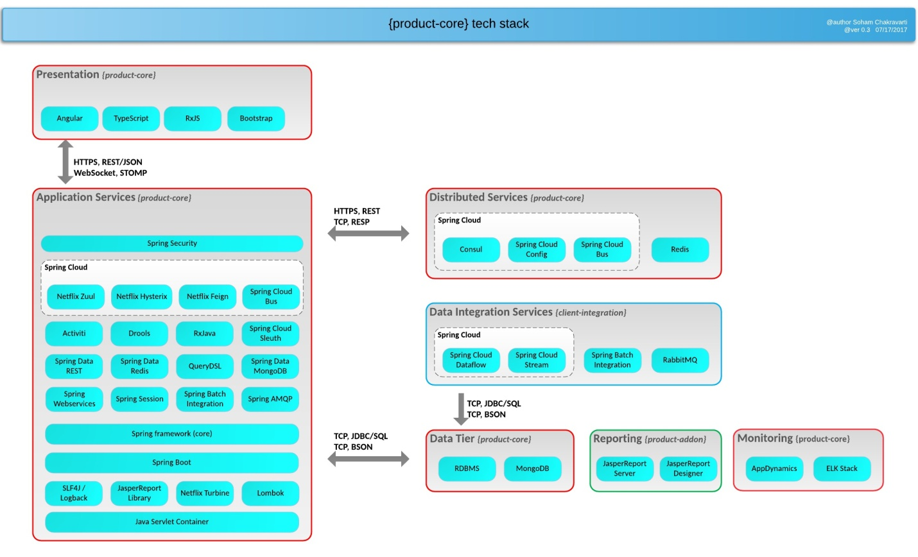
NIMBUS Framework
Notes:
The Nimbus Framework is a Java/Spring based platform dedicated to building highly configurable, workflow driven, and rich single page web applications through the use of configuration written atop the Java Virtual Machine and it is a collection of libraries and frameworks.
Benefits of using the Nimbus Framework:
Create new applications quickly.
Easy Configuration.
Cloud supportable .
Easily integrates with other systems.
Better User Interfaces , through code generation.
Develop new UI Controls based on standardized UX.
UI widget for capturing e-signature, Data export and Import.
Ability to print a view and generate a pdf of the printable view

Slide 12
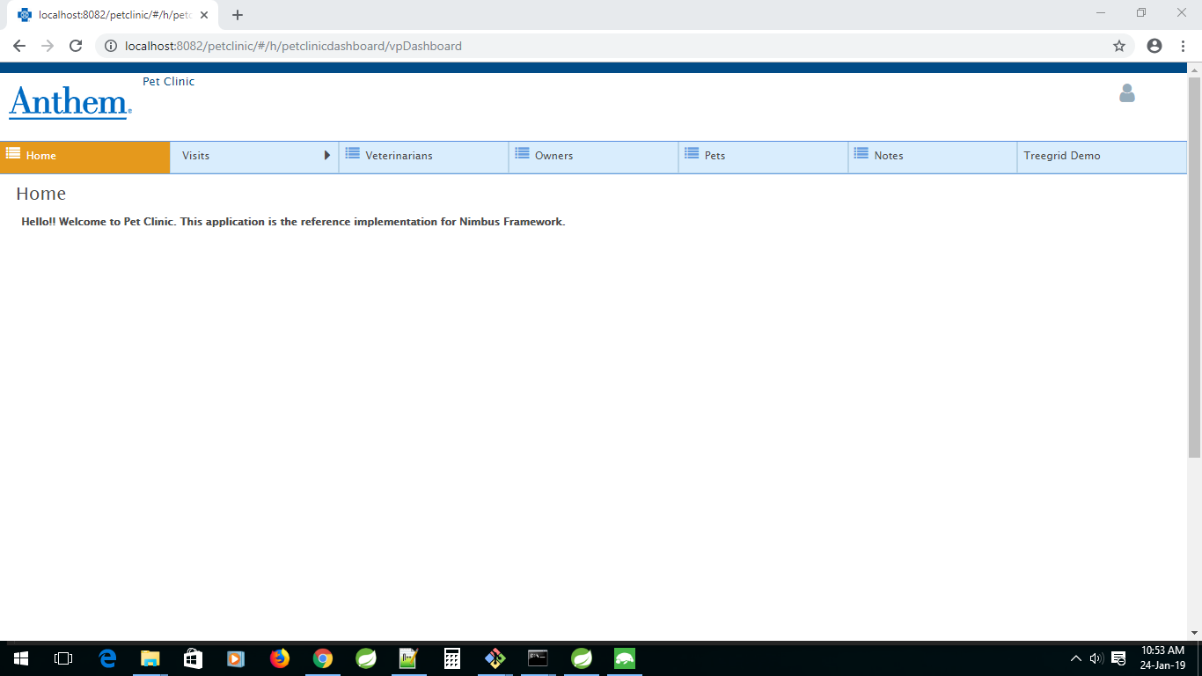

Slide 13
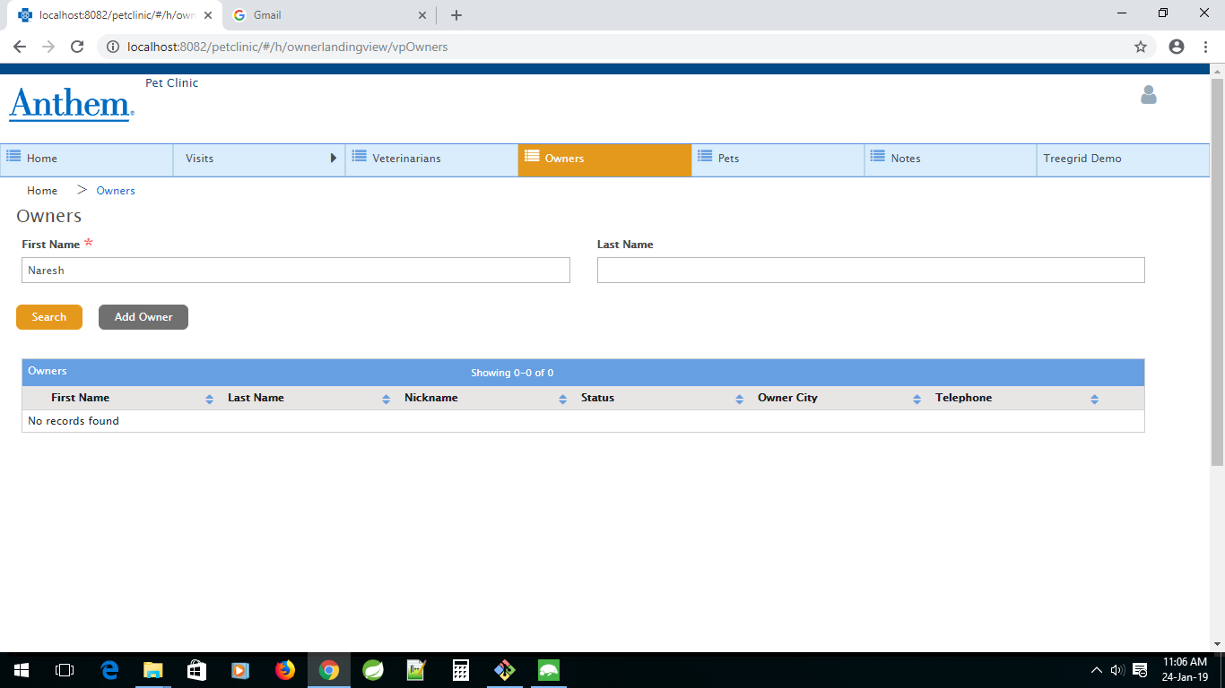

Slide 14
Why Anthem made NIMBUS framework as OPEN source? How is it useful for outside Anthem ? Can we build any other applications (non Anthem ) also using NIMBUS framework.
The intent of making Nimbus Framework as open source is to provide support for software engineers in creating new applications based on current and emerging best practices by creating a flexible, expandable product that can grow and change as its customer’s needs with less cost and effort.
We can develop and build any External (non anthem) web and distributed application using nimbus framework.

Slide 15
NIMBUS Team Details
Development & support for
Care management applications LTSS Case management
Client Admin for CMDM
Client Admin for LTSS
Admin Builder(Assessment Builder , Tasks Builder,..)
Agile project with 2 week Sprints
15 member team including offshore and onsite, 3 to 8 team members per scrum team
Experience ranging from 4 to 18 years
Team skilled in Java, Spring boot, Microservices, Mongo DB, Angular, Selenium
Onboarding process for new joinees reduced to 2 weeks to become productive in Sprints

Slide 16


Project Details & Scope
Care Management Domain
LTSS, Utilization Management,
Case Management Disease Management,
Health & Wellness, BH(Behavioural Health)and EAP are the major components of the Care Management Domain
LTSS-Long Term Services and Support
LTSS is a Medicaid product serving members to meet the need of Long term services and support.
It is a Home and Community based services provided through Medicaid for Individuals who are deemed chronically disabled and /or elderly that requires on going services and supports to meet their functional and medical needs.

Slide 17
Project Details & Scope contd…
CMDM(Healthy Innovations platform)
Multi-disciplinary, nurse-led clinical support for members, during and following hospitalizations, or for those with certain chronic conditions, such as asthma, diabetes, and chronic obstructive pulmonary disorder, etc. Case management includes specialized staff for behavioural health, social work, transplant/bariatric and oncology.
Case Management is a collaborative process of member support that evaluates , develops , implements and coordinates options, resources , and services.
Nurse case managers educate support members to empower self-reliance in best managing their Health. It includes working one-on–one with members, their families, and other members of the interdisciplinary care team.
Through Case Management, members understand their options , access available services, and participate in managing their health care needs.
So finally Case management helps members create and achieve personalized goals to optimize their health and also get quality healthy care by use of their benefits.
Notes:
Case Management user Journey for NCM
Enrol member in a program.
Open a Case.
Create a Care Plan.
Conduct an Assessment
Adjust Barriers, Goals, interventions.
Case Maintenance
a. Add , modify , close an Activity
b. Add notes to a case.
c. Add medication
d. Close a case
7. Dashboard(NCM View)

Slide 18
Contd…
As part of new CMDM application (product) development the below two sub-products are delivered as part of Wave-1
Cmproductadmin
Cmproduct
USE CASES
This product will take care of the below activities (Use Cases) performed by different user / user groups (Case Admin, Case Manager, case supervisor, ENROLLMENT SPECIALIST etc., ) Member Identification (manual) process
Case Assignment
(Navigator) Create (Open) Case
(System) Assign Case to CM
Initial Outreach
(BH CM) Schedule Initial Outreach
(BH CM) Complete Initial Outreach (Call) & Assessment
(BH CM) Schedule Follow Up
Care Plan Development
Create Care Plan: Goals, Interventions and Barriers
Ongoing Care Management
Complete Follow Up
Reassess Member
Update Care Plan
Case Closure
Notes:
The Case Management Administration allows you to configure Various items within the Case Management UI.
An CM operation Administrator can:
Configure the CM process workflow
Configure the Programs , Activities , Management Reasons,..
Create Case Managers, Supervisors ,Teams …
Configure roles , authorization and set user privileges
Create , upload & maintain clinical content using Admin Builder and Assessment Builder
Configure some parts of the user Interface such as descriptive text , options in menus and dropdowns lists.

Slide 19
Technical Expertise : Java / Nimbus
Project Nimbus supports Anthem’s next generation care management platform
Multi payer – competitive edge over existing systems in the market
Performance based and lower cost of care for consumers
Cloud and container architecture to reduce time & cost for customer integrations
Enabling new functionality through configuration instead of code
Product targets Payers & Providers , supports close integration with other systems
Challenges
Strategy
Achievements
Java – new practice from scratch in Dec 2017
Framework was slow to build and had poor reference docs
The team had to learn the framework and apply it simultaneously while delivering user stories
The team got trained on MongoDB during weekends to work on the applications
Continuous training – Java 8, Selenium, Angular
Better onsite –offshore communication with fine grained status reports and tight feedback loops
Developer workflow checklists for better story analysis, estimates and delivery tracking
Offshore QA to improve quality and reduce delays.
Cross team training, lightning talks and story walk-throughs
Sprint metrics and feedback
Ramped up from delivering small tasks to full features in 4 months
Delivered complex features with BPM flows & rest service integration
Sprint velocity exceeded client expectations with a 20% increase per quarter
Reduced internal defect rate to near zero
Additional scrum team in the works for new client application

Slide 20
Best Practices
Category | Implementation Details
Code Quality | Consolidated the code review comments at the end of every sprint and the same was discussed with the team.
Continuous Learning | Monitor and discuss with teams on their required trainings and facilitate the same through class room / online
Development Process | Defined a step by step process for the development of User Stories and conducting the follow-up sessions with each team to ensure uniform and high quality developer workflow
Offshore QA | Tracking estimated due dates, testing and reducing defect rate (improved FTQ)

Slide 21
Value Added Items
Problem Statement | Solution Details
Every developer has to manually update the maven encrypted passwords for maven repository every time when the Anthem password is changed / maven installed | Created a batch file for auto generating the encrypted passwords for settings.xml and settings-security.xml in .m2 directory ( ~ saves 12 mins)
Need to prevent repetitive PR review comments | Automate the process and generate consolidated PR review comments from BitBucket. This helps to understand the repetitive review comments to focus and make sure avoid the same in future

Slide 22
Success Stories
Addressing VM performance issues
Git access to raise PRs to develop branch
Access to BAs and Backlog grooming
Fixed time for Onsite calls
Daily recaps and status update emails by DEV team
Coverage by additional developers on each team to maintain 5 or more members
Demos during development
Focus on accuracy with Offshore QA’s testing
Focus on code quality
Focus on test coverage
Focus on timely delivery
On-going effort to improve offshore in framework and related skills
Significant time reduction in new team member on boarding
Structured KT Process for new team members including NIMBUS training
Mongo DB and Java8 class room trainings

Slide 23
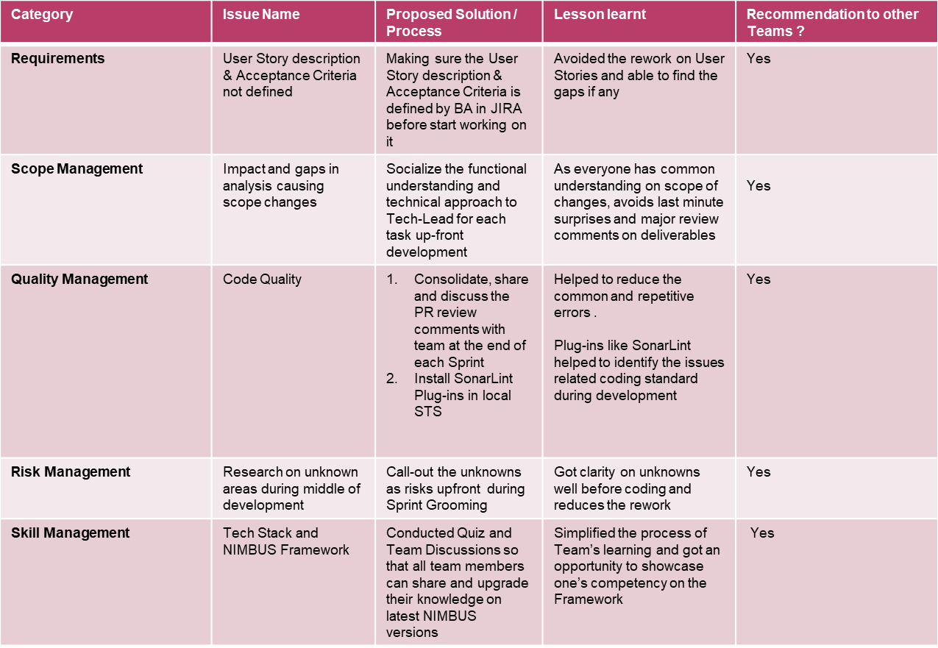
Lessons Learned

Slide 24
Questions ???

Slide 25


